Slide 1


Santa Rosa Marble
Doral, United States
February 2021
Hiram Fleitas
Fleitas Arts
github.com/hfleitas/srm
Notes:
Image ref: https://img-prod-cms-rt-microsoft-com.akamaized.net/cms/api/am/imageFileData/RE2x0JM?ver=a32f&q=90&m=6&h=600&w=1600&b=%23FFFFFFFF&l=f&o=t&aim=true

Slide 2
SRM App
Use-Case
Search
Product
Inventory
Sales
Hiram Fleitas
Fleitas Arts
github.com/hfleitas/srm
Notes:
Image ref: https://img-prod-cms-rt-microsoft-com.akamaized.net/cms/api/am/imageFileData/RE2x0JM?ver=a32f&q=90&m=6&h=600&w=1600&b=%23FFFFFFFF&l=f&o=t&aim=true

Slide 3











Hiram Fleitas
Owner Fleitas Arts
Bio
Father
Principal DB Architect
Power Platform since 2016
Developer since 1995
SQL Server since 1999
USCG Auxiliary Flotilla Staff Officer
@hiramfleitas
/hfleitas
hiram@fleitasarts.com
hiramfleitas
fleitasarts.com

Slide 4
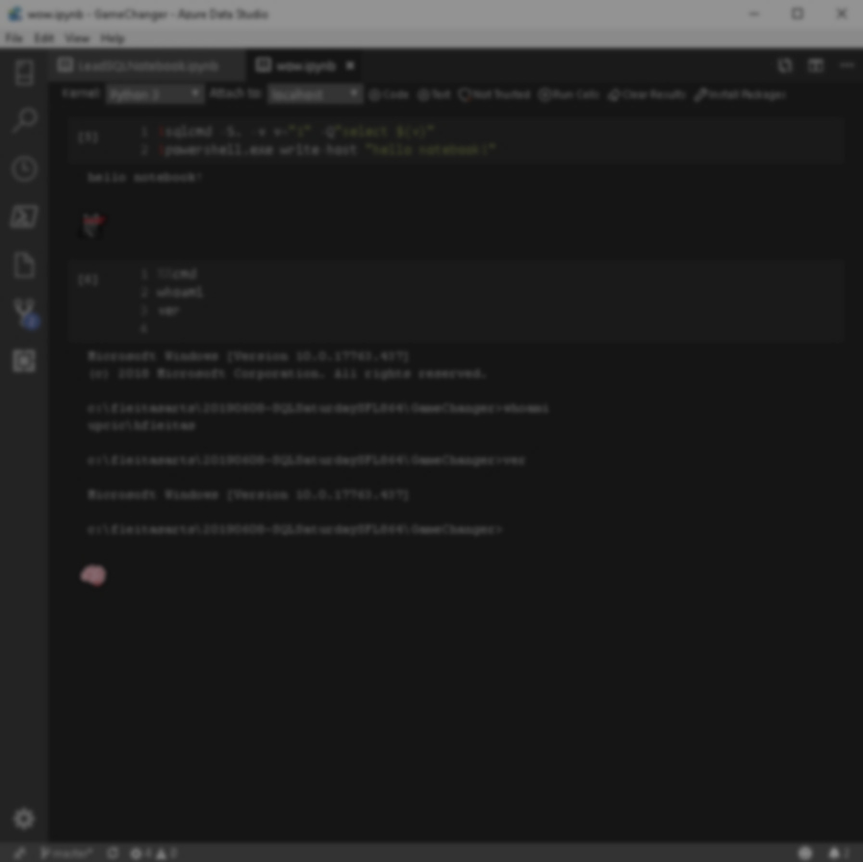

Agenda
Search
Details
Photos
Edit
Add
Cart
Resources

Slide 5

Adapt. Now more than ever.
Work together to meet challenges effectively.
188%
ROI over three years
3.2 hours/day/employee
Average improvement in line-of-business employee productivity
74%
Reduction in app development costs
Notes:
hero_desktop.jpg (2880×1662) (azureedge.net)
https://go.microsoft.com/fwlink/?LinkId=2126953&clcid=0x409

Slide 6

Home
Search by Name or Code.
Search by Picture
Go to Cart
Help
View items in Mixed-Reality

Slide 7
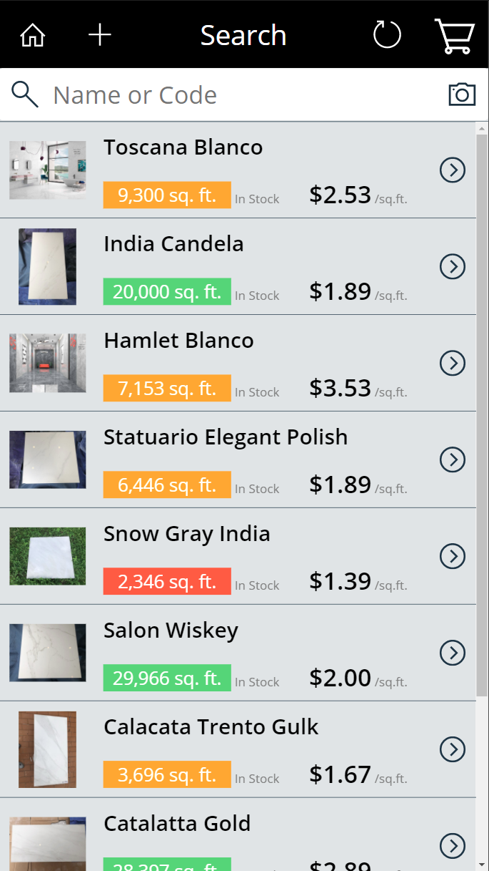
Search
Back Home
Add Product (Access Control)
Refresh Screen
Go to Cart
Search (type input)
Search by Photo
Primary Photo (Go to Photos)
Name
Total Sqft in stock (Color coding based on Threshold)
Price per sqft.
Go to Details

Slide 8
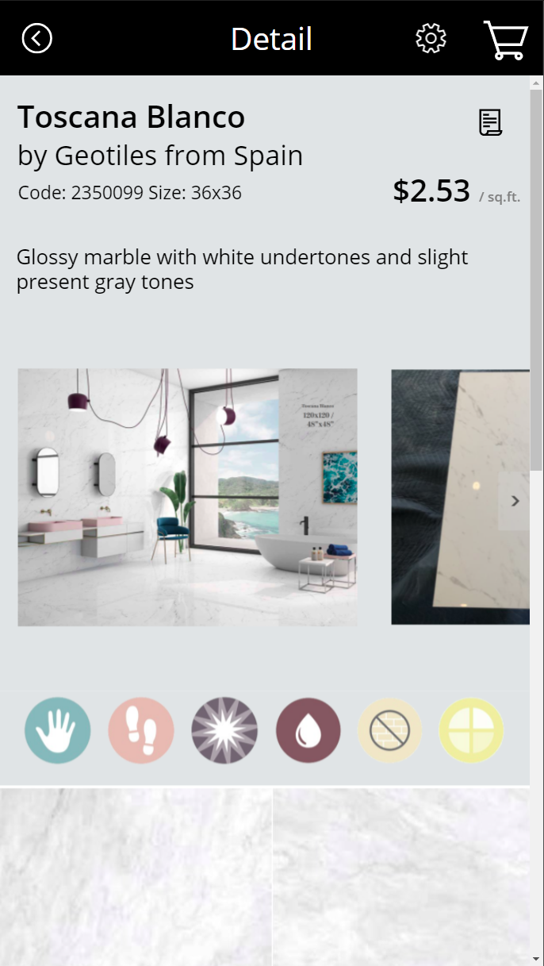
Detail
Back to Search
Edit (Access Control)
Go to Cart
Go to Manufacture Catalog
View Cost (Access Control)
Photos (Scroll Horizontal, Go to Photo when pressed)
Detail page (Scroll Vertical)

Slide 9
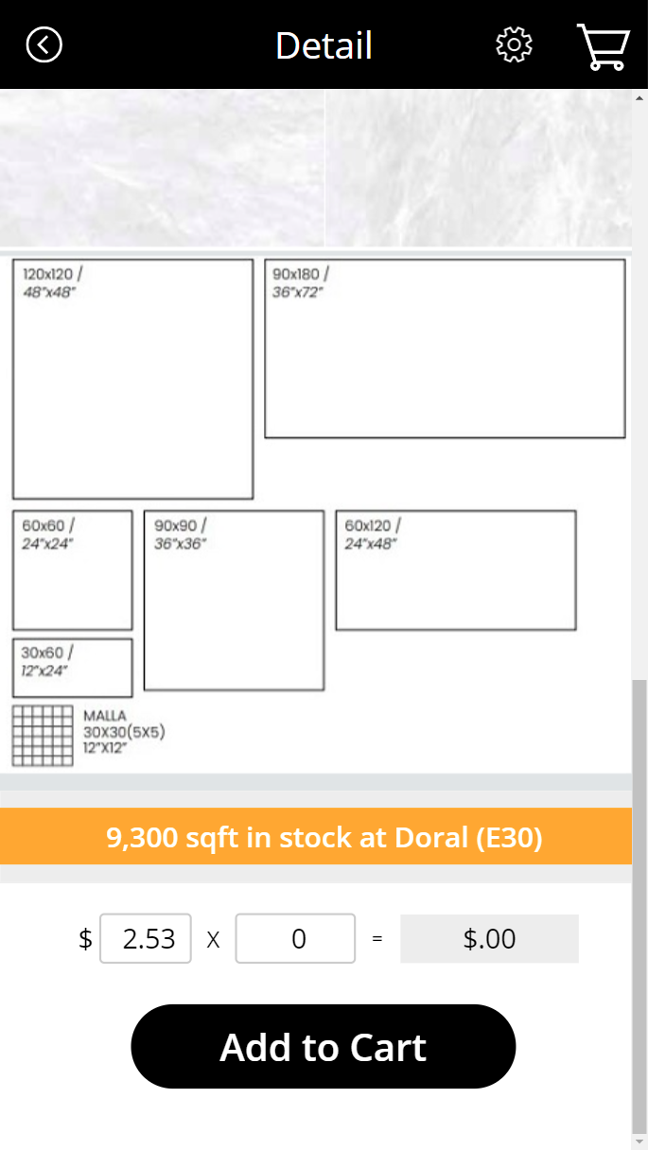
Detail
Full product & inventory details.
Inventory info and location (Pending add Tone info)
Add to Cart desired sqft quantity. (Shows Total $ for Quantity and Goes to Cart)
Edit Price (Access Control) when adding to Cart to apply discount.
Shows sum $ discount amount.

Slide 10
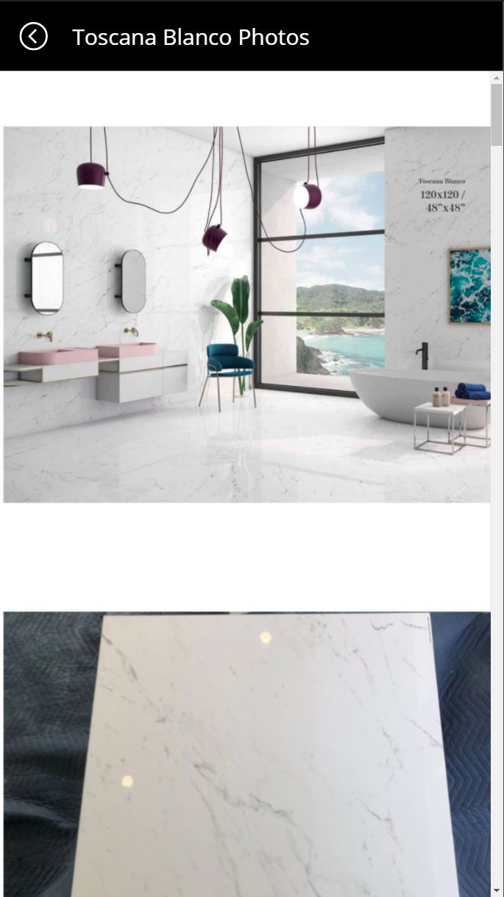
Photos
Go Back
Zoom into Photos using Pinch gesture
Unlimited Photos (Import Automatable)

Slide 11
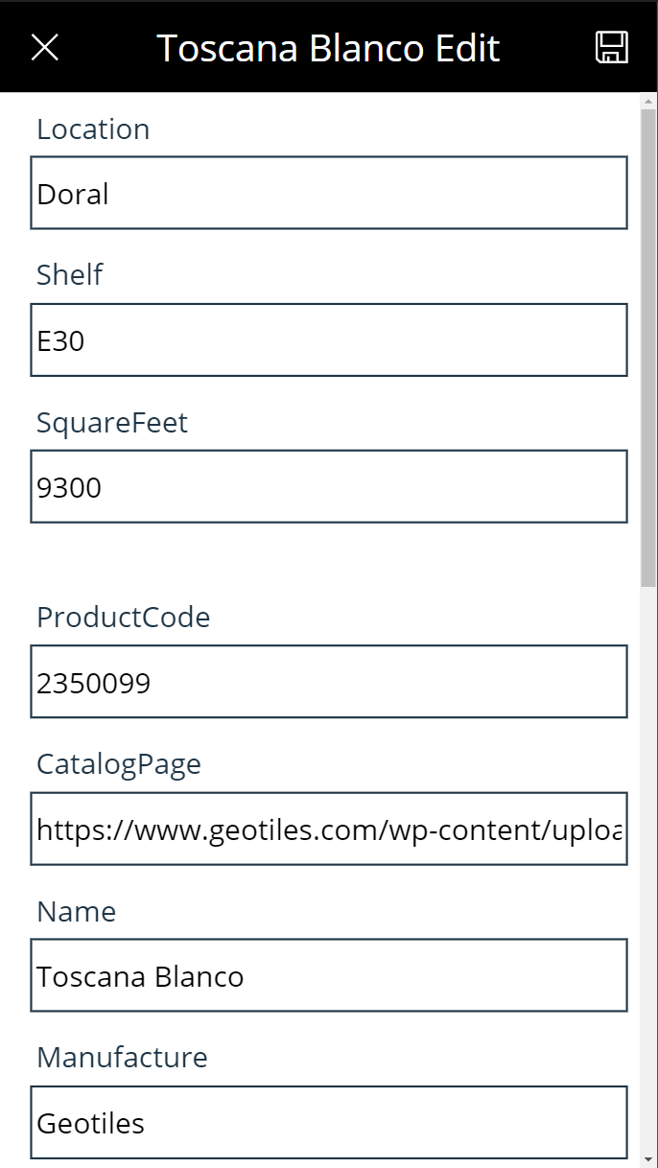
Edit
Cancel (Go Back) / Save changes.
Edit all fields of an existing product.
Primary key ProductCode for consistency between Product and Inventory.
Access Control
Audit, Security & Backups in-place.

Slide 12
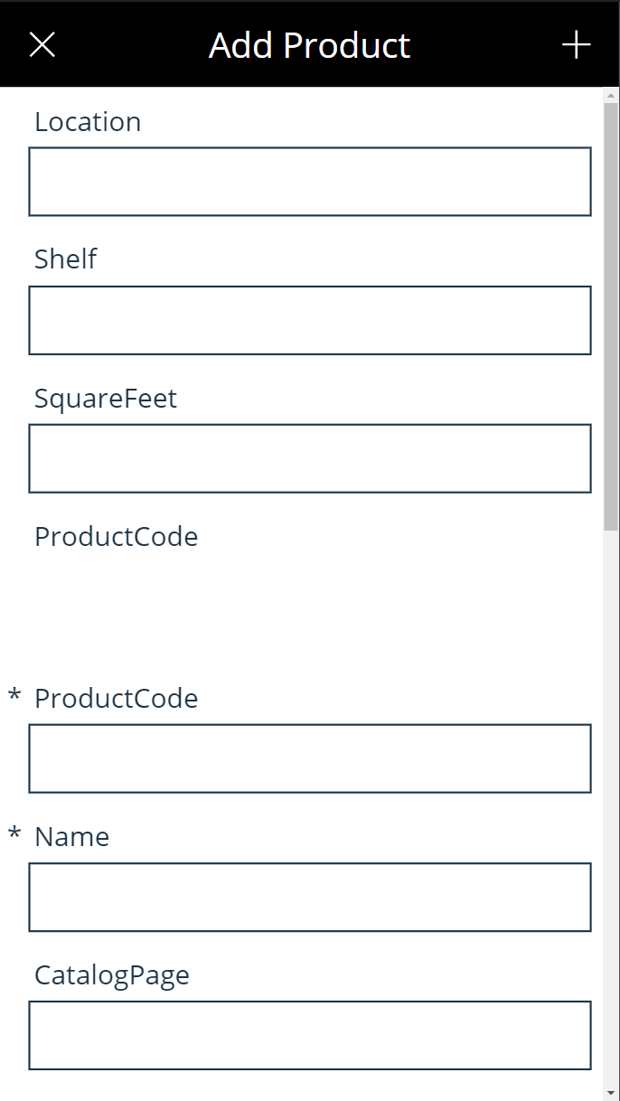
Add
Cancel (Go Back) / Add new product.
Add info for all fields.
ProductCode and Name are the 2 required fields.
All fields can be Edited after.
Primary key ProductCode for consistency between Product and Inventory.
Access Control
Audit, Security & Backups in-place.
Unlimited Products (Import Automatable)

Slide 13
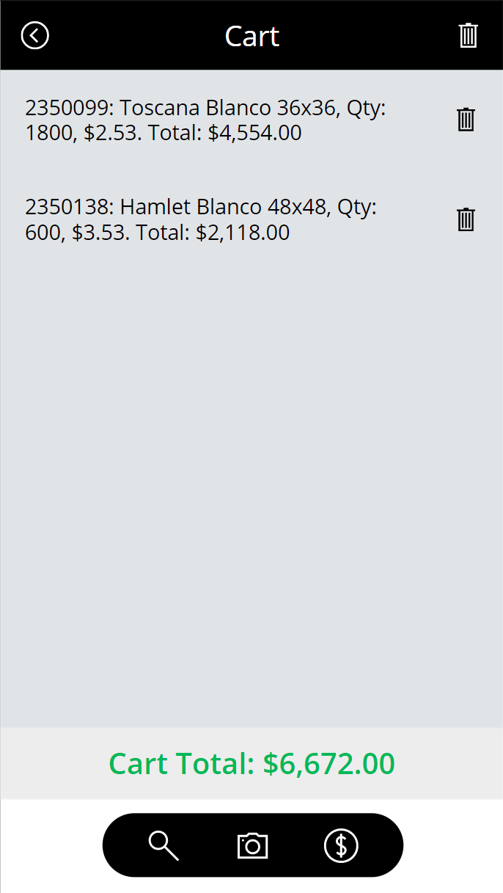
Cart
Go Back (Continue Shopping, doesn’t clear cart).
Clear Cart.
Items in Cart with Sub-totals.
Delete individual item from Cart.
Cart Total.
Back to Search (Continue Shopping)
Search by Photo (Continue Shopping)
Checkout (Emails Cart to Cashier at Point-of-Sale system)
Sales Report

Slide 14

DEMO 1
App Intro
Notes:
SRM - Power Apps

Slide 16
DEMO 2
Cart
Notes:
SRM - Power Apps

Slide 18
DEMO 3
Edit / Add Product
Notes:
SRM - Power Apps

Slide 20
DEMO 4
Photos
Notes:
SRM - Power Apps

Slide 22
DEMO 5
Bonus: Ai Features, Analytics
Notes:
SRM - Power Apps

Slide 24


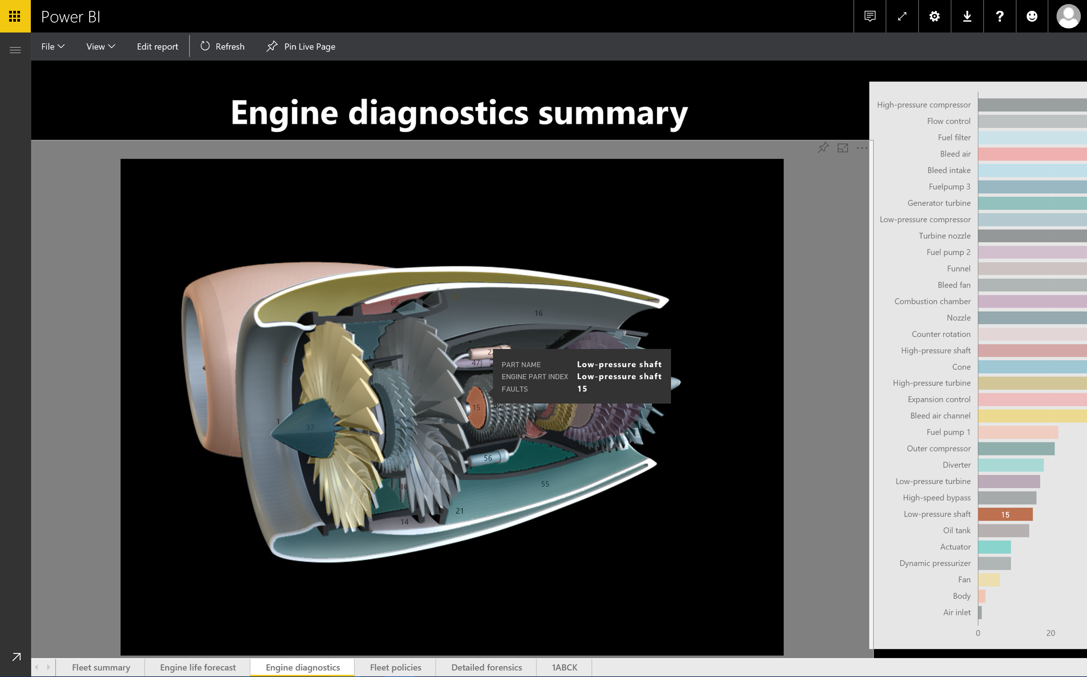
End

Slide 25
Summary
Search
Details
Photos
Edit
Add
Cart
Search by Photo (AI)
Mixed Reality (AI)
Resources

Slide 26
Resources
SRM - Power Apps v128
fleitasarts.com
github.com/hfleitas/srm
ROI Case Study
Notes:
SRM - Power Apps

Slide 27
Hiram Fleitas
Owner Fleitas Arts
@hiramfleitas
Thank You
hiram@fleitasarts.com
fleitasarts.com
/hfleitas
hiramfleitas

